Slide 1
The ICAPS community needs to reach out more to other “decision-making” communities in order to
educate others on how our techniques can help them to solve their problems
educate ourselves on how other techniques can help us to solve our problems
inform others on what artificial intelligence and planning is all about TODAY

Slide 2
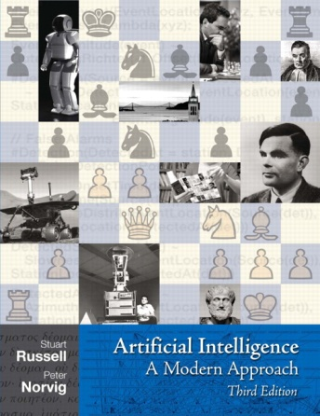
Artificial Intelligence
… a rational agent should select an action that is expected to maximize its performance measure …
Artificial Intelligence: A Modern Approach

Slide 3
Artificial Intelligence
4.1. Local Search Algorithms and Optimization Problems ... 120 4.1.1. Hill-climbing search ... 122 4.1.2. Simulated annealing ... 125 4.1.3. Local beam search ... 125 4.1.4. Genetic algorithms ... 126

Slide 4
Artificial Intelligence
16.1. Combining Beliefs and Desires under Uncertainty ... 610 16.2. The Basis of Utility Theory ... 611 16.2.1. Constraints on rational preferences ... 612 16.2.2. Preferences lead to utility ... 613 16.3. Utility Functions ... 615 16.3.1. Utility assessment and utility scales ... 615 16.3.2. The utility of money ... 616 16.3.3. Expected utility and post-decision disappointment ... 618 16.3.4. Human judgment and irrationality ... 619 16.4. Multiattribute Utility Functions ... 622 16.4.1. Dominance ... 622 16.4.2. Preference structure and multiattribute utility ... 624 16.5. Decision Networks ... 626 16.5.1. Representing a decision problem with a decision network ... 626 16.5.2. Evaluating decision networks ... 628

Slide 5
Artificial Intelligence
17.5. Decisions with Multiple Agents: Game Theory ... 666 17.5.1. Single-move games ... 667 17.5.2. Repeated games ... 673 17.5.3. Sequential games ... 674
17.6. Mechanism Design ... 679 17.6.1. Auctions ... 679 17.6.2. Common goods ... 683

Slide 6
Artificial Intelligence
17.1. Sequential Decision Problems ... 645 17.1.1. Utilities over time ... 648 17.1.2. Optimal policies and the utilities of states ... 650 17.2. Value Iteration ... 652 17.2.1. The Bellman equation for utilities ... 652 17.2.2. The value iteration algorithm ... 652 17.2.3. Convergence of value iteration ... 654 17.3. Policy Iteration ... 656 17.4. Partially Observable MDPs ... 658 17.4.1. Definition of POMDPs ... 658 17.4.2. Value iteration for POMDPs ... 660 17.4.3. Online agents for POMDPs ... 664

Slide 7
Making Good Decisions
Science of Making Good Decisions (by optimizing a given objective function)
Artificial Intelligence
Operations Research
Economics
Decision Theory
Control Theory
…

Slide 8
AI and OR
Science of Making Good Decisions (by optimizing a given objective function)
Artificial Intelligence
Operations Research
CPAIOR: International Conference on Integration of AI and OR Techniques in Constraint Programming for Combinatorial Optimization Problems

Slide 9
What to do?
Joint summer schools with other communities
Joint workshops with other communities
Invited ICAPS speakers from other communities
Sessions on planning at other conferences
Send targeted information material to other communities (e.g. dissertation abstracts)
… (your ideas here) …

